Slide 1
Code Camp

Slide 2
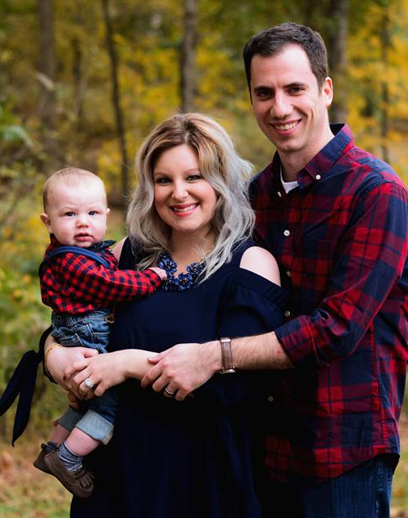
About Me
Born/raised in Nashville
Live in Mount Juliet
Married w/ Kid
Outside of Work
Investing
Video Games
Learning

Slide 3
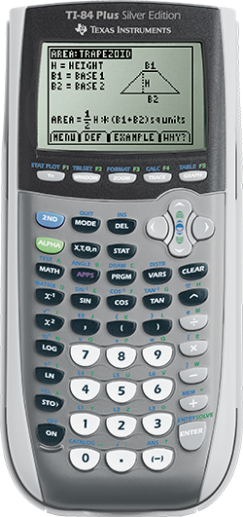
First Starting
First started programming on a TI-84+ calculator
8th grade
Programmed Formulas
Made a Video Game
Started learning C++ in high school
Studied Computer Science at TN Tech
What is Computer Science

Slide 4
Computer Science
Really just figuring out how solving a problem quickly
Computers can be good at this
Algorithms
Fancy word for steps to solve a problem
Sudoku solver demo

Slide 5

Advanced CS
AI
http://psych.fullerton.edu/mbirnbaum/psych101/Eliza.htm
Graphics
Distributed computing
Databases
Demo
Operating Systems

Slide 6
Career
Two Summer Internships with Aflac
Web Application Development
First Job with Asurion (2012-2013)
Started working with Dynamics AX (ERP System)
Build analytical tools around it with SQL Server and Analysis Services
Moved to the BI Team
Microsoft BI Stack – SQL Server, Analysis Services, Integration Services, Reporting Services
Contracted w/ Cigna Healthspring (2013-2014)
Database work for a Web App
More SSIS, but now with Agile SCRUM!

Slide 7
Career
naviHealth (2014-2016)
Built Data Warehouse from ground up
Instilled Agile Practice within team
Database Source Control (not common at all!)
Visualizations w/ Tableau
ThinkDataInsights (2016-Current)
Consultant building Analytics Platforms for small-medium size business
Lots of PowerBI
SQL Server, SSAS Under the hood
Azure Data Platform

Slide 8
What I do today
Data Architecture
Design systems to store large amounts data
Be able to answer a variety of business questions quickly
Machine Learning
Regression – Fancy word for guessing how long or how much
Classification – Fancy word for guessing a multiple choice question
Clustering – Fancy word for grouping things together
Visualization
Fancy word for charts and graphs

